Slide 1
Introduction to genomics
Week 1, Computational Genomics
Notes:
Intro
High level introduction of genomics and how does the Broad play a role in it
Where does computation play a role in it
Syllabus for the course
Setup your computers!

Slide 2
Human genomic revolution: past, present, and future
samples → variants → genes → cell types → processes → disease
What excites you in your field of study?
Where in your scientific background or personal life has intersected with genomics, and what do you want to learn more about in genomics?
Notes:
Eric Lander’s talk: https://www.youtube.com/watch?v=VAvMSzBJaqQ
A big part of the course is to recognize that we all come from different scientific backgrounds from all over the country, and it is important to learn that from each other as we learn a very interdisciplinary scientific practice.
What excites you in your field of study?
Where in your scientific background or personal life has intersected with genomics, and what do you want to learn more about in genomics?
This lesson is to give a recap of what Eric talked about in the context of our course, and give a roadmap of what this summer is going to look like.

Slide 3
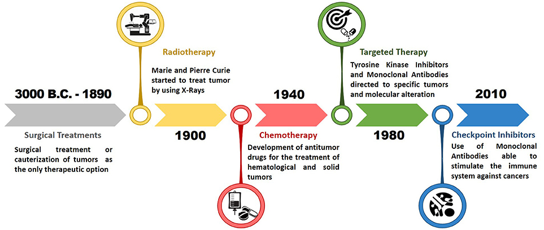

Our focus this summer: cancer genomics
What comes next?
Cell therapies?
Gene therapies?
Phage therapies?
Personalized therapies?
(up to you all and discoveries about the basic biology of cancer)
Strongly recommended:
(for a history of cancer biology)

Slide 4
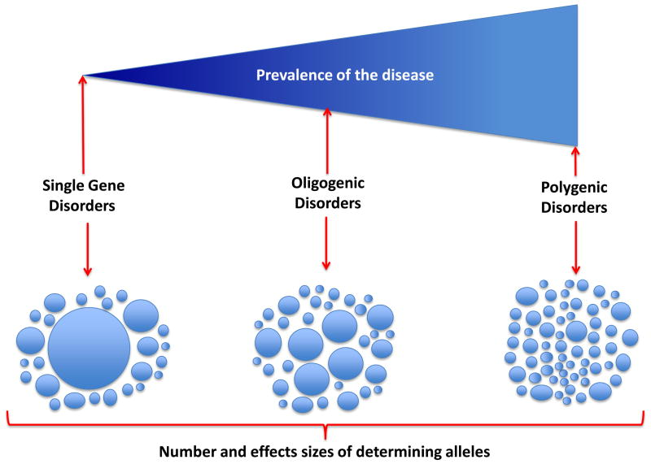
Human genomic revolution: past, present, and future
samples → variants → genes → cell types → processes → disease
Notes:
Why is sequencing of the human genome useful?
If we want to understand the genetic cause of disease, the map of samples to variants was made systematically possible through the human genome project.
Sample: disease phenotype, variant: genotype.
Eric gave several disease examples throughout the talk: sick cell anemia, alzheimers disease. We are going to focus on cancer this summer.
Before the human genome project, variants associated with a disease are mapped through genetic maps via linkage analysis. (Sickle Cell Anemia). You needed families, pedigrees, physical markers (short tandem repeat markers, SNPs) to find the genetic distance between disease phenotype and physical markers (positional cloning, recombination freq, LoD scores). These physical markers gives approx physical distance in order to pinpoint/estimate the loci of the disease-causing gene. One can PCR that location to find the gene.
The human genome project made it possible that one can have access to genomic landscape of alterations so that the mapping process no longer needs an intermediate physical marker, so one can quickly find a candidate variant associated with the disease. This allowed the study of mendelian diseases with acceleration: close to 5,000 mendelian disorders mapped. The genes, cell types, and processes are straight-forward -- there’s only one variant, with strong penetrance, and rarely occurs in the population.
What about polygenetic disorders, such as cancer?
Terminology/concept check:
What’s the difference between genetics and genomics?

Slide 5
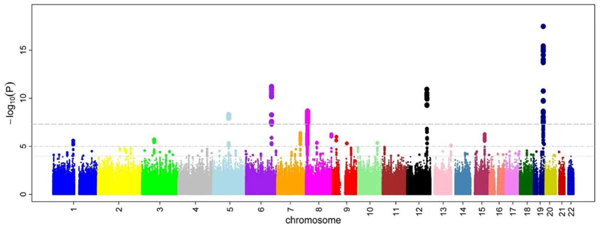
Human genomic revolution: past, present, and future
samples → variants → genes → cell types → processes → disease
Association with phenotype
Genome location
Notes:
Studying polygenetic diseases
Need a huge sample size
GWAS returns a huge number of candidate variants causal for the disease
Fine mapping is needed
90% Non-coding regions: which gene? (obesity example)
Which cell type? Pathway type? Mechanism?
(Take a look at https://www.ebi.ac.uk/gwas/diagram to see the amount of variants annotated over the years.)
(Example of a variant to function study: https://youtu.be/18nOsCsuSc4?t=3880
He starts to look at data beyond just DNA to uncover the mechanisms.)
(To do look at polygenic disorders, one needs have a more complete picture of total human genetic variation, because there are many variants contributing to a disease.
How does one do that? WGS was still expensive, so the next project after the human genome project is to build a haplotype map.
Haplotype - a group of alleles that are inherited together from a single parent
Haplogroup - a group of haplotypes that share a common ancestor.
If one reads an allele from a haplogroup, then one should be able to predict the genotype of other alleles in the haplogroup with some accuracy.
Hapmap project was used for haplotype imputation as genomic sequencing was still expensive.
Genotyping just a few SNPs to understand an entire haplotype block (using linkage disequilibrium metrics)
$100 can genotype one person vs. $3 billion for the human genome project
With that, able to use genome association studies to identify variants associated with non-mendelian diseases.)

Slide 6
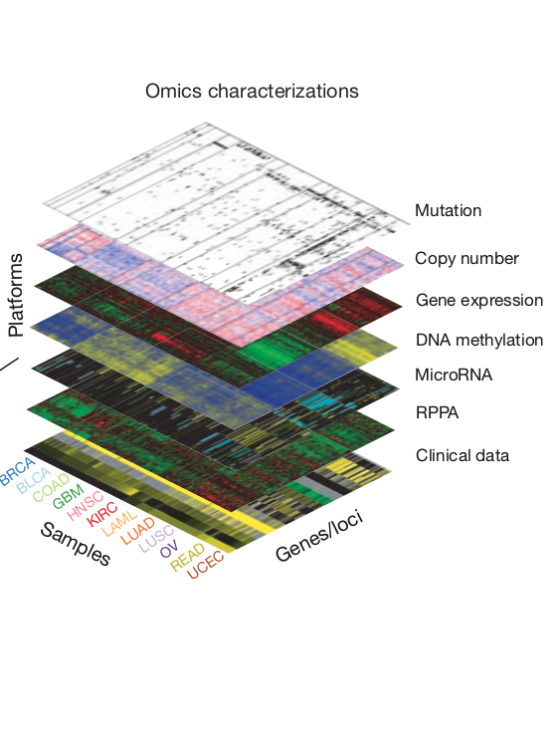
Human genomic revolution: past, present, and future
samples → variants → genes → cell types → processes → disease
Question <-> Data <-> Technology
Notes:
To go from variant to disease (genotype to phenotype), one needs a lot more complex data besides just DNA readout:
consider the central dogma of molecular biology
Transcriptional and translational regulation
Cell and tissue signaling
As you saw in the video, the disease context drive the motivation to do deep profiling of different genomic features, cell type, and model systems. Projects start to emerge that focus on a particular disease: today, there are consortiums on infectious disease, psychiatric disease, rare genetics, etc.
With a question about a disease, we ask whether we have the data and technology to study it well. Besides the human genome project and Hapmap project, numerous biotechnology advances in sequencing were being made. Genomics, as we alluded to before, is looking at DNA, RNA, epigenetics, protein to assemble a mechanistic story.
The summer’s focus is on cancer genomics, using resources from Broad’s cancer program.
What are the questions unique to the disease that requires specific data? Do we have the technology?
Cancer: is less driven by heritable, germline variants, but much more by somatic events.
These are strong, mitotic events.
Haplotype imputation won’t find all the variants one is looking for.
Need to sequence the exome or genome, tumor/normal comparisons.
Somatic mutations, copy number changes, gene expression, methylation, microRNA, clinical data…
(Specialized analysis in studying somatic alterations: problem of tumor purity, so allele fractions are very continuous.)
TCGA project - deep profiling of omics and cancer subtypes.
---
(Specific questions in the field that people ask.
What are the drivers of cancer? What are the passengers? What pathways is it associated with?
How does identifying drivers lead to targeted therapies?
How does cancer evolve through time?
How does cancer resistance occur?
What are the signatures that occur from environmental effects?
Other specific genomic datasets:
ENCODE (epigenetics)
GTEx (tissue specific expression and regulation)
Genome Aggregation Database (extension of HapMap - SVs, etc.)
UK Biobank

Slide 7
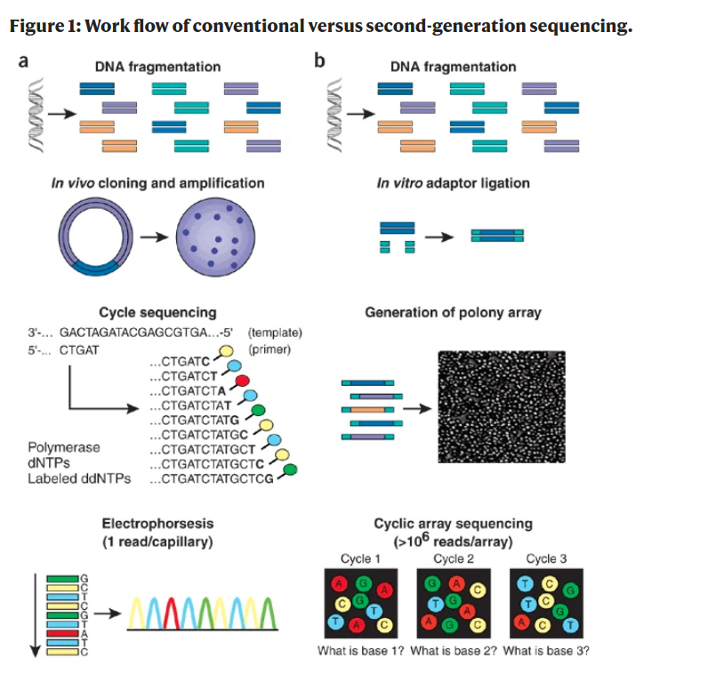
Question <-> Data <-> Technology
Notes:
What made all of this data generation and analysis tools possible?
One big difference is that this technology is becoming digital.
Computationally,
Computational software to analyze the results
Accurate methods to align
Genotype (germline, somatic)
That is the connection to make for computational genomics.
---
Rapid advancement in technology, in digital form.
Sanger sequencing
Array based technologies
Second, third-gen sequencing technologies
Cost-effective illumina sequencing
Blood biopsy example
Single-cell sequencing
Nanopore sequencing
Functional perturbation

Slide 8
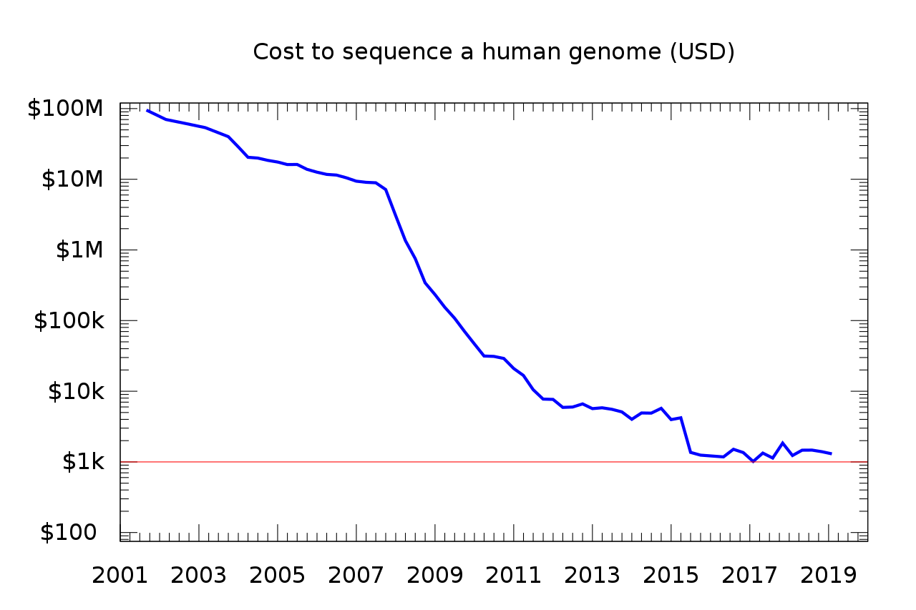
What is computational genomics? To make sense of all of this information.
Notes:
https://en.wikipedia.org/wiki/Whole_genome_sequencing, NHGRI
Not only there’s a connection between biology and computers, the cost is decreasing the amount of data generated is increasing.

Slide 9
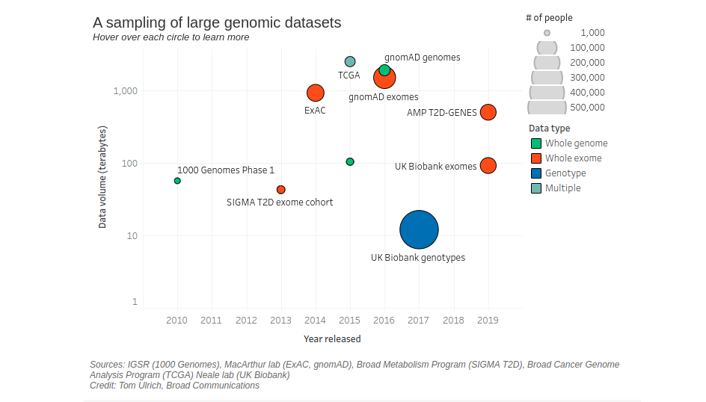
“Genomic datasets double in size roughly every eight months,” said Eric Banks, senior director of the Broad Data Sciences and Data Engineering (DSDE) group. “It’s a level of growth that for years has far exceeded Moore’s law.”
Notes:
https://www.broadinstitute.org/blog/harnessing-flood-scaling-data-science-big-genomics-era

Slide 10
How is genomics data generated?
Gather samples and clinical data
Molecular biology sequencing prep
Sequence samples
Alignment to reference genome using software
Quality control using software
Extracting genomic features using software
Answer biological question using computational analysis
Notes:
Use “How is genomics data generated?” to frame which part of the comp. genomics we will be focusing on this summer.

Slide 11
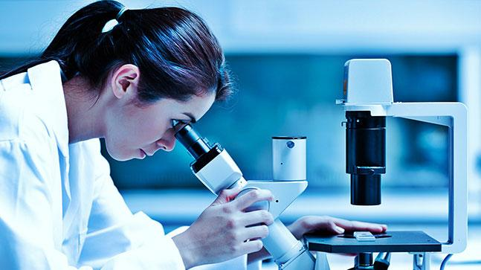

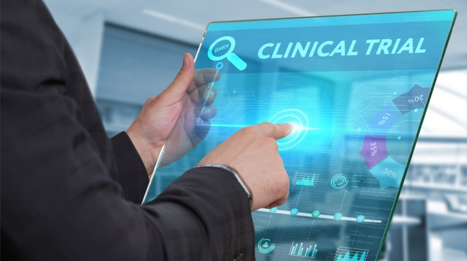
Pipeline of data from “bench to beach”
“Leads” (chemicals with anti-cancer properties)
High throughput biology experiments
Computational analysis and lead generation
Validation and clinical studies
(Literally Cooper right now)

Slide 12
Learning how to code is like learning a new language
There is...
Grammar structure
Vocabulary
Culture
A new way to think about a problem!
Requires lot’s of practice, and referring back to our language in common
Notes:
Culture emphasis - what kind of questions are tackled in coding, and who gets to tackle the problems? We will be starting from scratch in this course, in a collaborative way.

Slide 13
The goals this summer:
biological question <-> computational analysis
samples → variants → genes → cell types → processes → disease
Notes:
Underlying these modules are scientific foundations in computer science and statistics.
The content of the course will cut across several different fields.

Slide 14
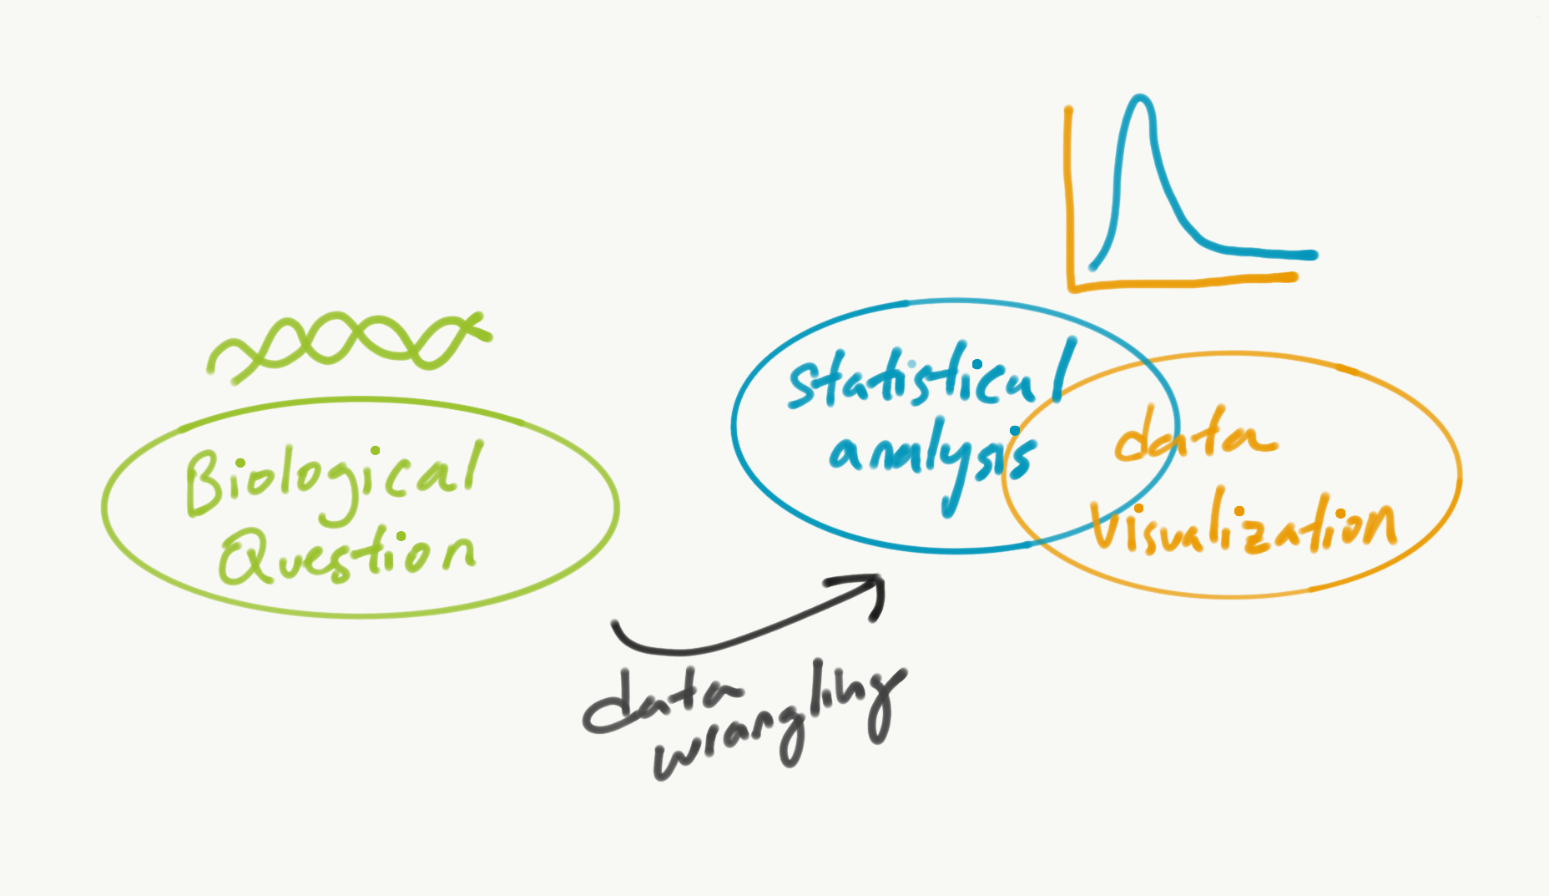
biological question <-> computational analysis

Slide 15
biological question <-> computational analysis
What variations do we see in Gene X within a population?
Is mutation of gene X associated with the development of a certain cancer?
Which genes are most differentially expressed under gene X’s mutation?
What biological pathways are associated with a set of genes?
Does gene X’s expression associate with gene Y’s expression?
Is gene X associated with gene Y’s deletion?
Notes:
Can you fill out any of this right now?
By the end of the course, we want you be able to fill these out, and be able to implement it in code!

Slide 16
Timeline of class
Weeks 1-5
Learning how to code in R
Exploring various genomics datasets
Data wrangling, visualization, statistical analysis
Cancer biology and cancer genomics through CCLE, DepMap
Lessons (2/week), Discussions (Fridays), Problem sets (due Friday or Monday)
Weeks 5-9
Group projects with guidance from Broad Computational Associates
Meetings, Presentations, Scientific talk
Coworking space with peers, teams, and instructors

Slide 17
Setup
Google Classroom invitation
https://classroom.google.com/c/MTkxNDg5MTAwMDI4?cjc=6xydvqk
Install R and Rstudio
https://cran.r-project.org/bin/macosx/base/R-4.1.0.pkg
https://download1.rstudio.org/desktop/macos/RStudio-1.4.1106.dmg

Slide 18
More Setup
1.
https://cds.team/taiga/token/
Copy token
In Terminal,
mkdir ~/.taiga/
echo YOUR_TOKEN_HERE > ~/.taiga/token
2.
git clone https://github.com/broadinstitute/taigr.git
3.
R
> install.packages(“devtools”)
> library(devtools)
> install("taigr/.")
Notes:
https://github.com/broadinstitute/taigr
Test Taiga:
metadata = load.from.taiga(data.name='public-21q1-4b39', data.version=33, data.file='sample_info', quiet = T)

